Slide 1

PROGRAMMATIC EVALUATION OF APACHE GROOVY
Ganesh Kumar Rajasekar - G37969806
Prudhvi Lakshmi Sesha Sai Cheedella - G22981341
Sai Nikhil Varada – G43353336
Yashwanth Raj Varadharajan - G47635180

Slide 2
Introduction
Optionally typed
Dynamic language
Built for the Java platform (runs on JVM) with many features that are inspired by languages like Python, Ruby, and Smalltalk, making them available to Java developers using a Java-like syntax.
Unlike other alternative languages, it’s designed as a companion to, not a replacement for, Java.
Groovy extends the java.lang.Object.
You can use existing Java libraries.
JavaOne slogan: Groovy is there for “extending the reach of Java.”

Slide 3
Names, Binding & Scopes
Names start with letters, digits & underscore character.
Uses both static & dynamic type binding
All variables created are public by default
Global variables – no keyword required, accessed throughout the script
Local variables, block-scoped – use ‘def’ or use the apt. datatype keyword

Slide 4
Data Types
Primitive Types: byte, short, int, long, float, double, char, Boolean, String
Object Types:
Java.lang: Byte, Short, Integer, Long, Float, Double
Java.math: BigInteger, BigDecimal

Slide 5
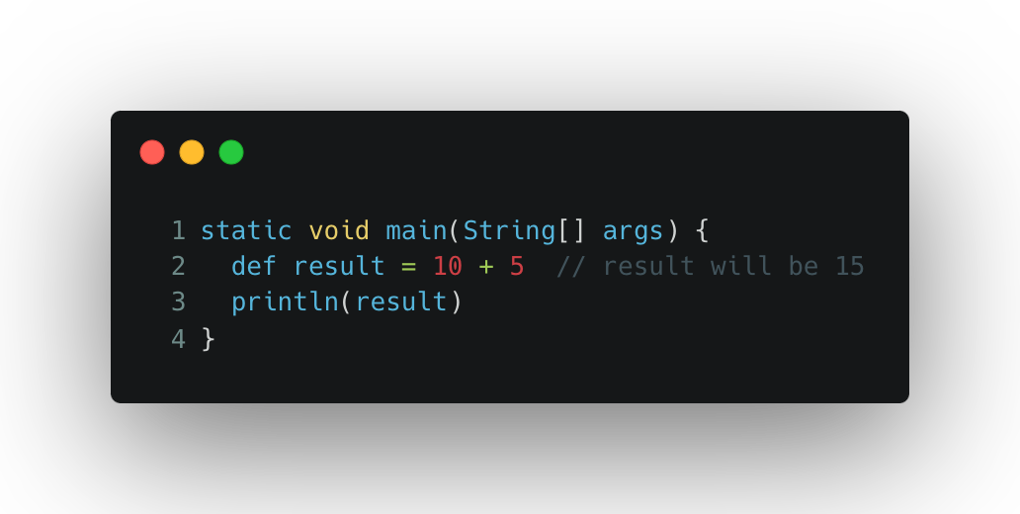
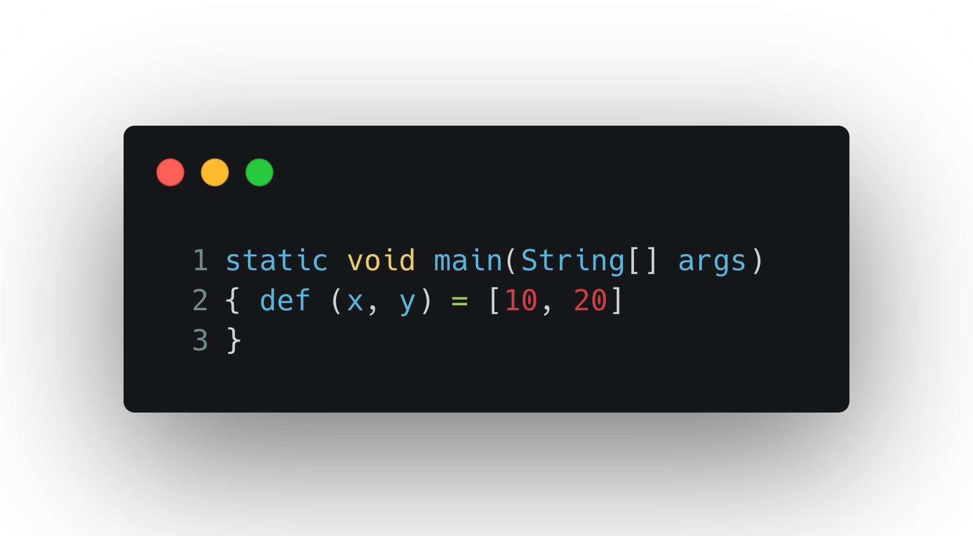
Expressions and Assignment Statements
To initialize a variable, we have to use the ”def” keyword.
Single assignment
Multiple Assignment

Slide 6
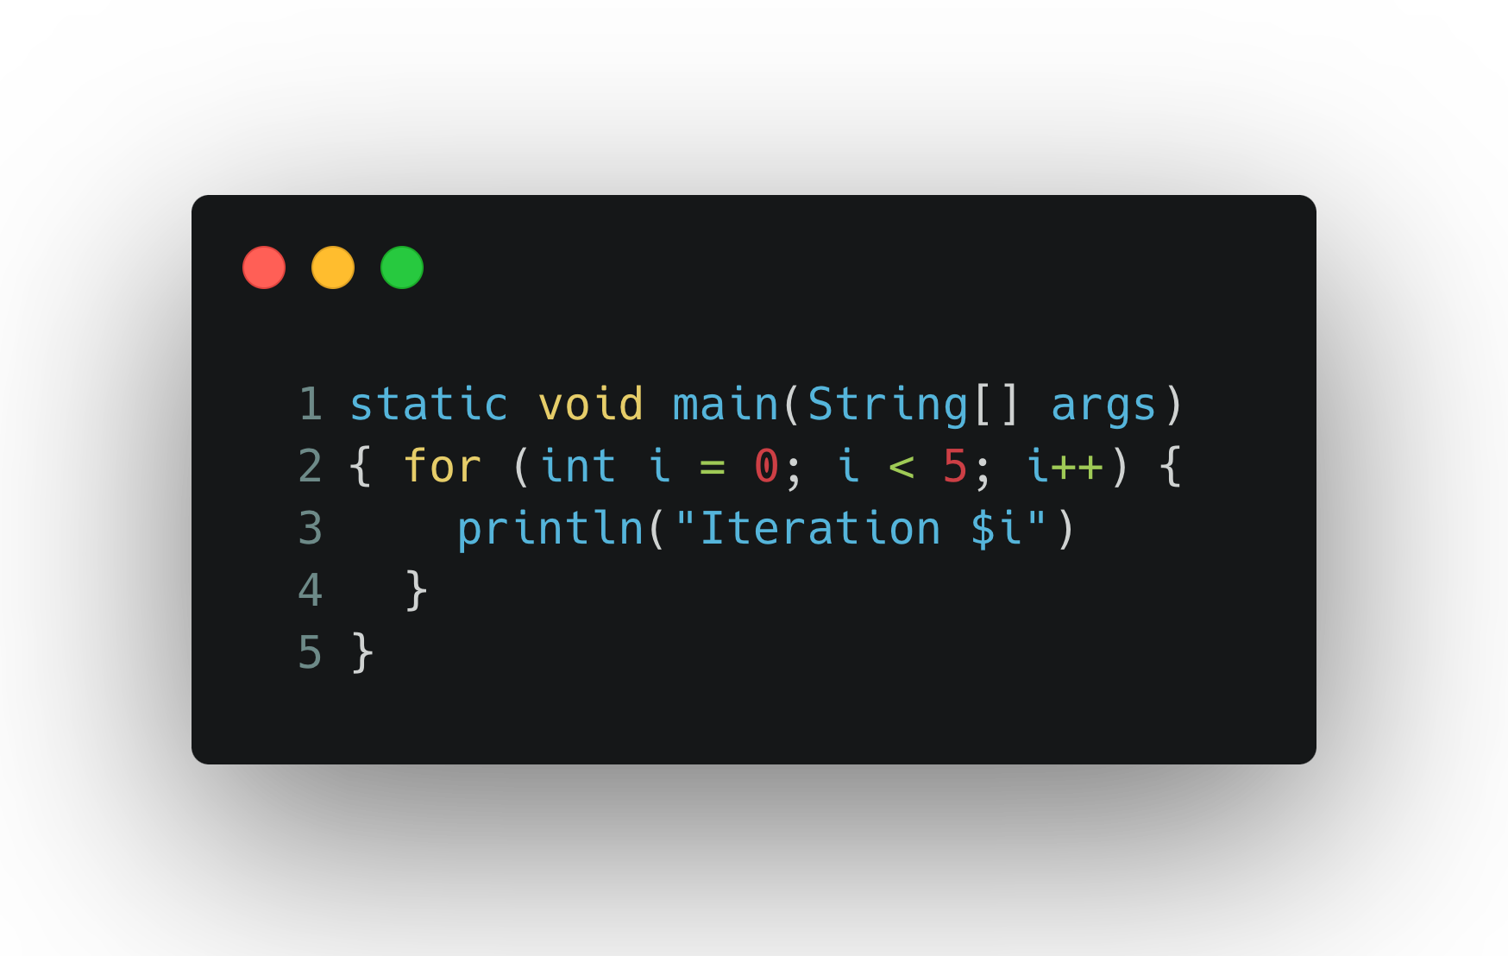
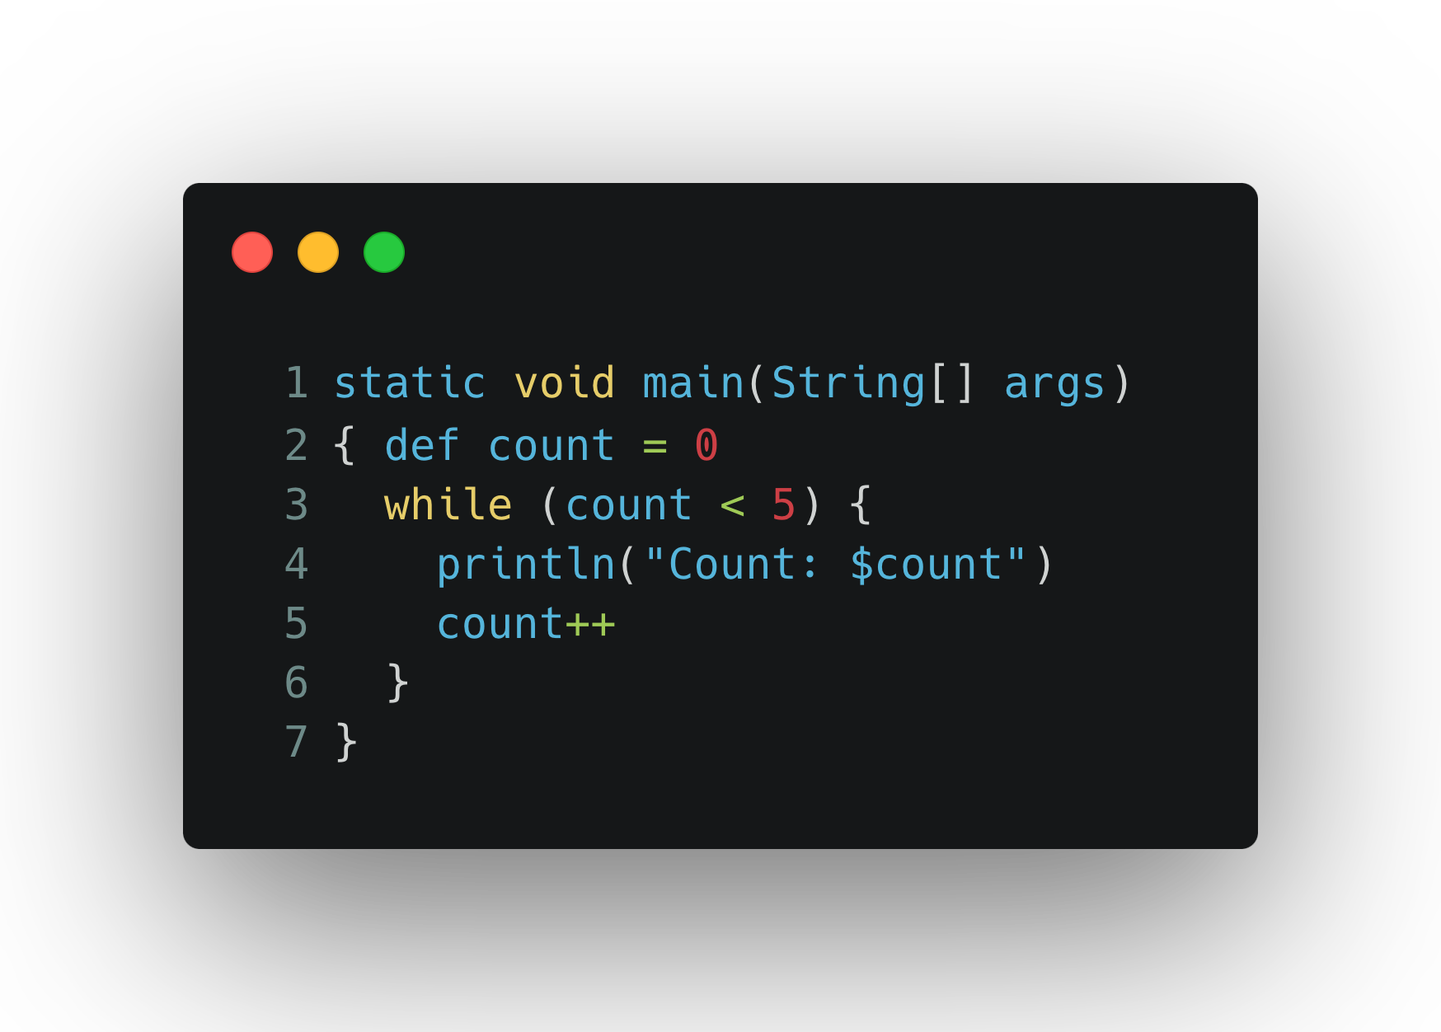
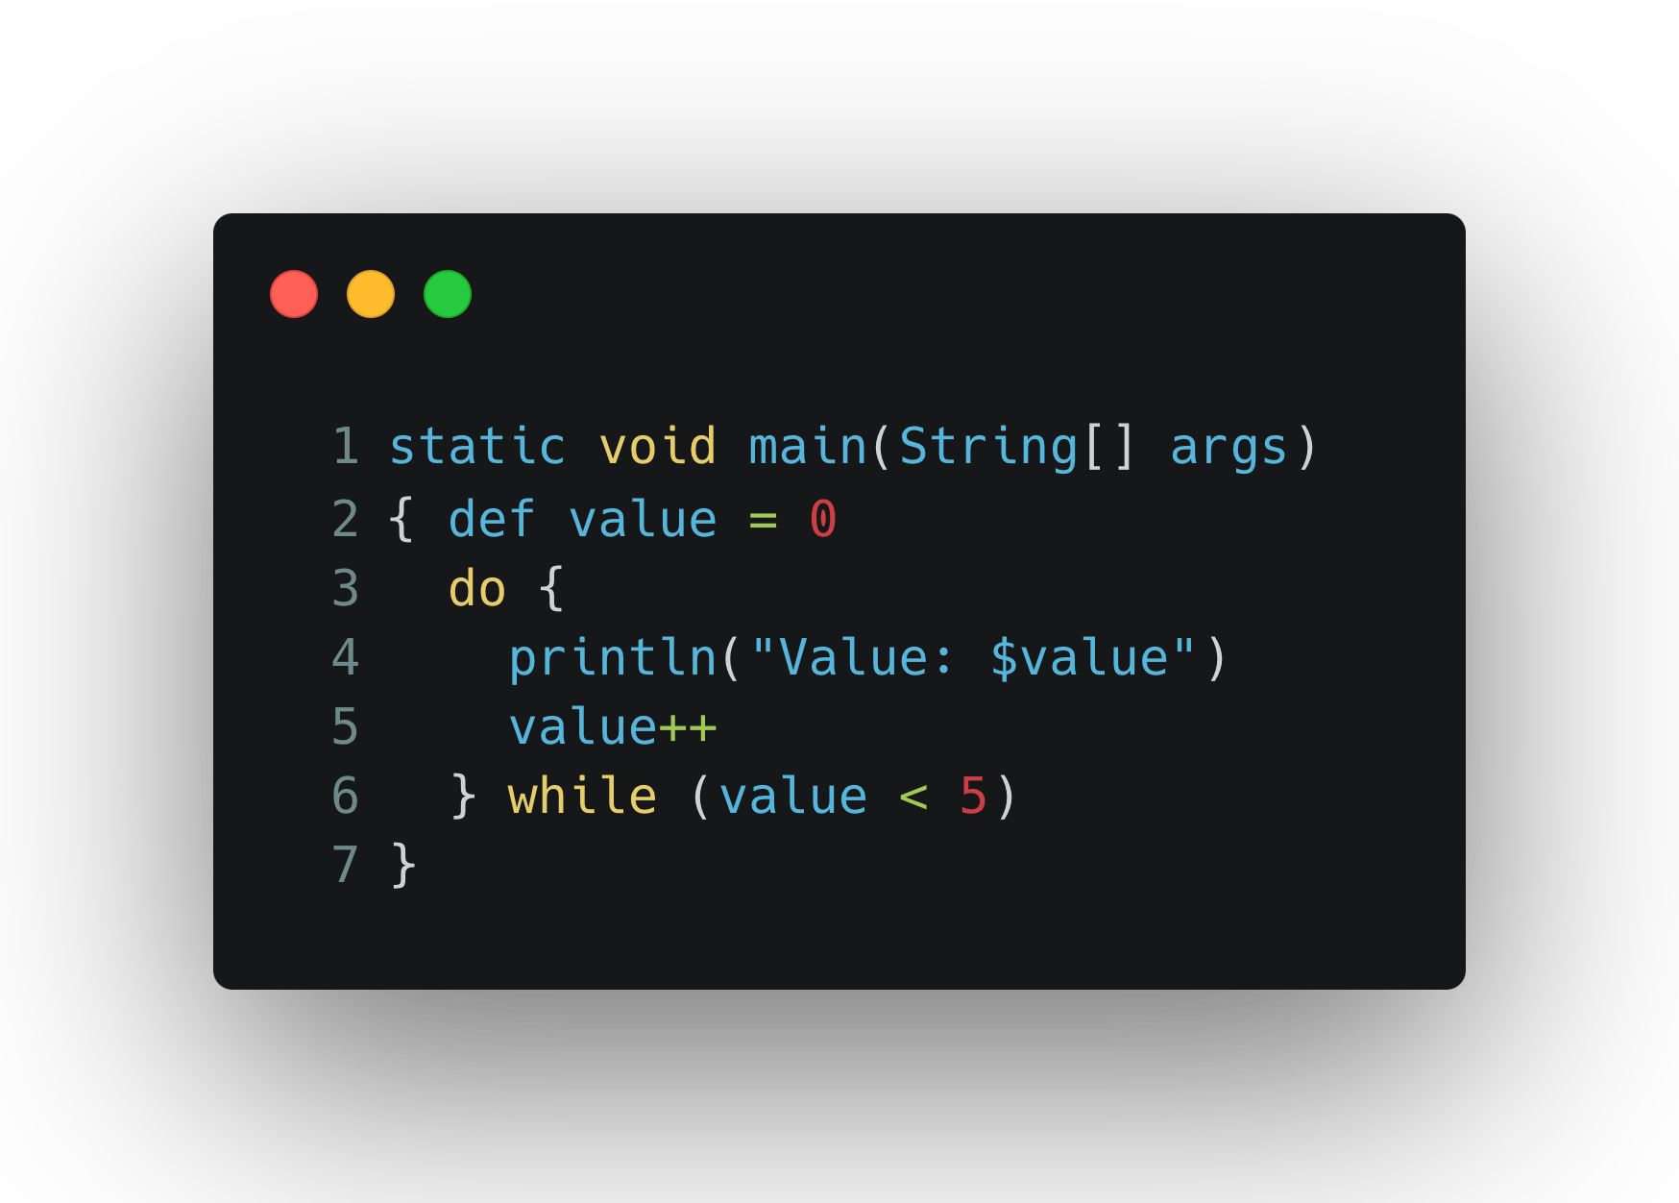
Loops
While Loop
Do While
For Loop
Apace Groovy also supports for loops like for-each, and for-in like python.

Slide 7
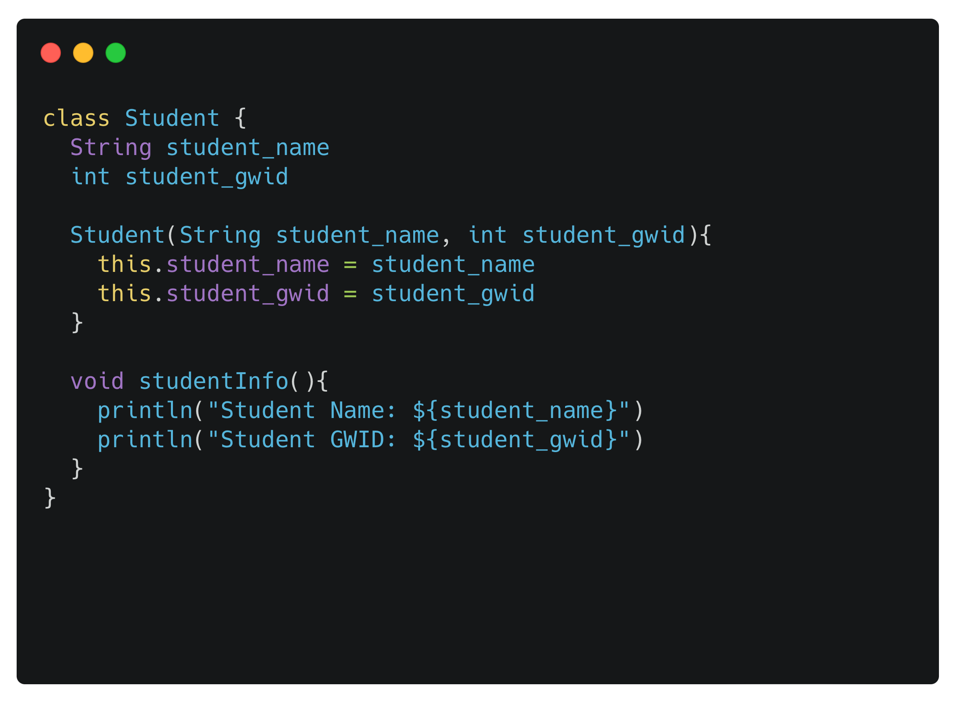
Object-Oriented Programming
Apache Groovy fully supports Object-Oriented Programming (OOP) principles
Class:
We have created a class called Student inside which we have two variables, student name and gwid number, default constructor and function to display the values of the variables

Slide 8
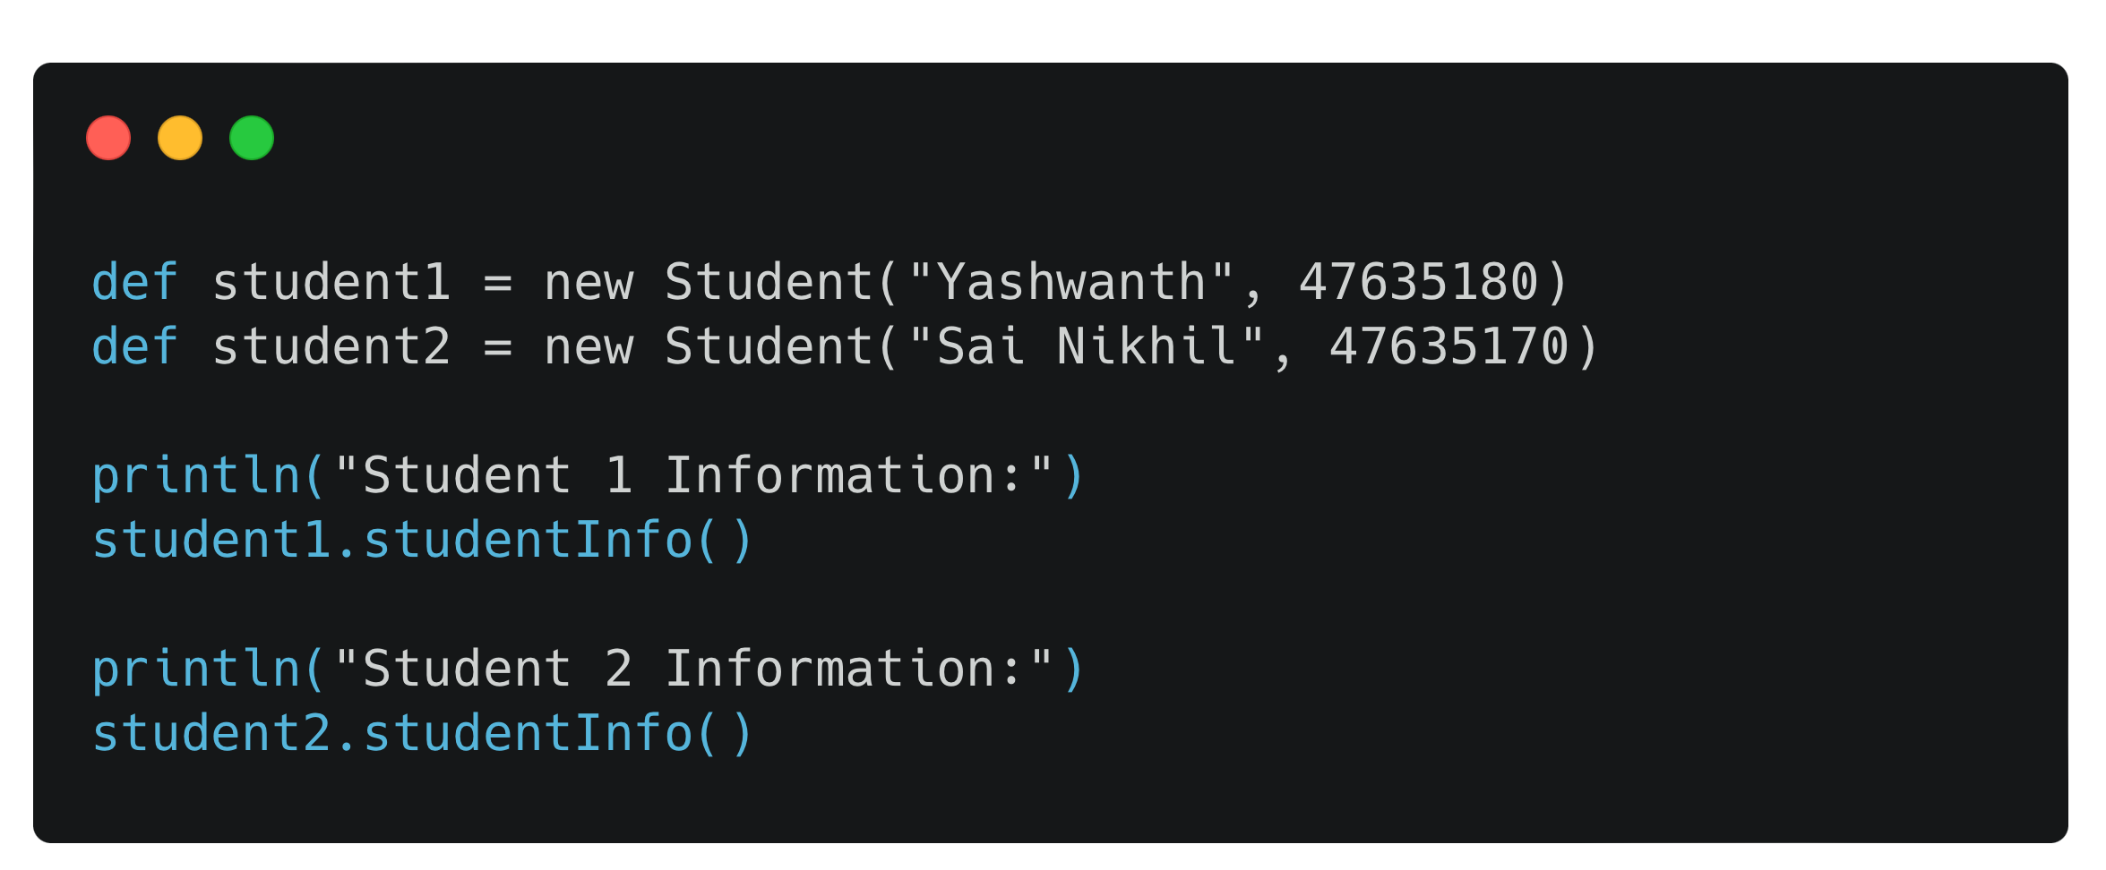
Object-Oriented Programming
Object
We now create two objects, student1 and student2. We have assigned two different values to the objects and use the studentInfo() function inside the class and print the values.

Slide 9
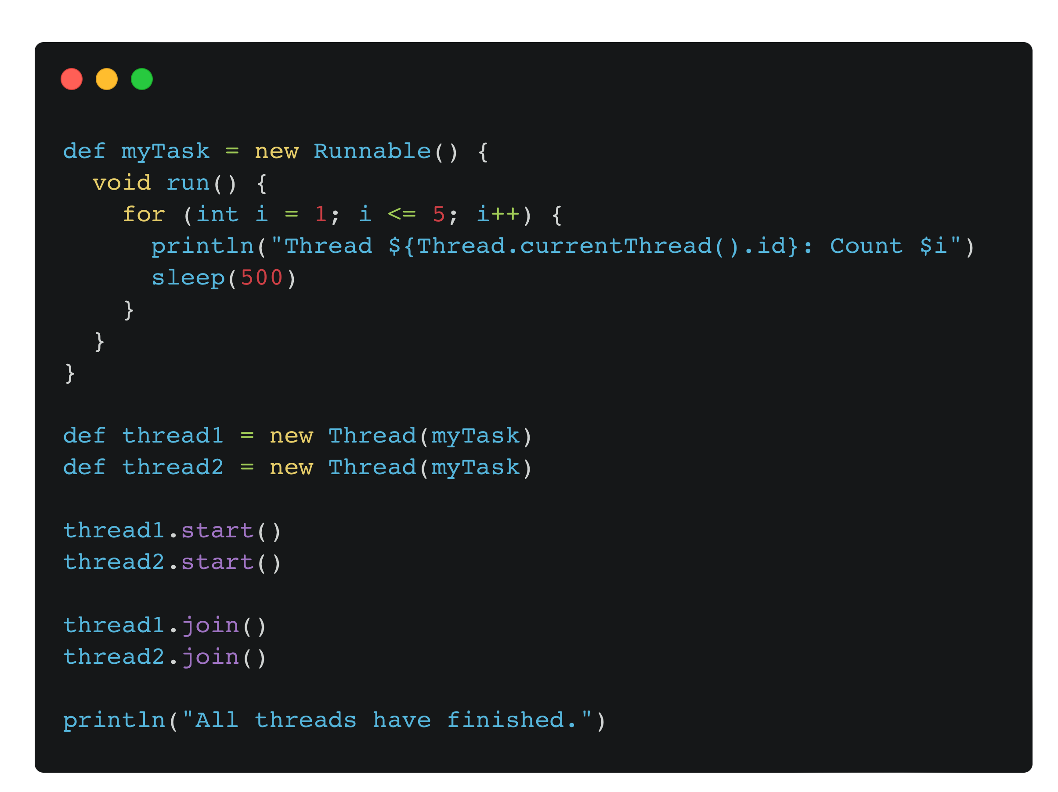
Concurrency
Apache groovy is a versatile language that is capable of running multiple processes simultaneously.
In the provided example, we have developed a program called "myTask" with two threads, named "thread1" and "thread2." We have utilized the "sleep" function to better visualize the working of program.
When we execute the program, we can observe that both "thread1" and "thread2" run at the same time.

Slide 10

GPARS
Dedicated library for the era of multi-core processors and concurrent programming.
Uses best concepts from emerging languages:
Actors library in Scala
SafeVariable class inspired by Agents in Clojure
Covers three main areas:
Starting and stopping concurrent tasks
Coordinating concurrent tasks
Controlling access to shared mutable state

Slide 11
Functions
Parallel collections with fork/join and map/filter/reduce operations are concepts that hide the work of starting and stopping concurrent tasks from the programmer and coordinate these tasks in a predefined manner
Actors are a frame in which asynchronous ops can be performed and be controlled explicitly.
Dataflow variables, operators, and streams coordinate concurrent tasks implicitly such that downstream data consumers automatically wait for data providers.
If your tasks need to access a shared mutable state, you can delegate the coordination of concurrent state changes to an agent.

Slide 12
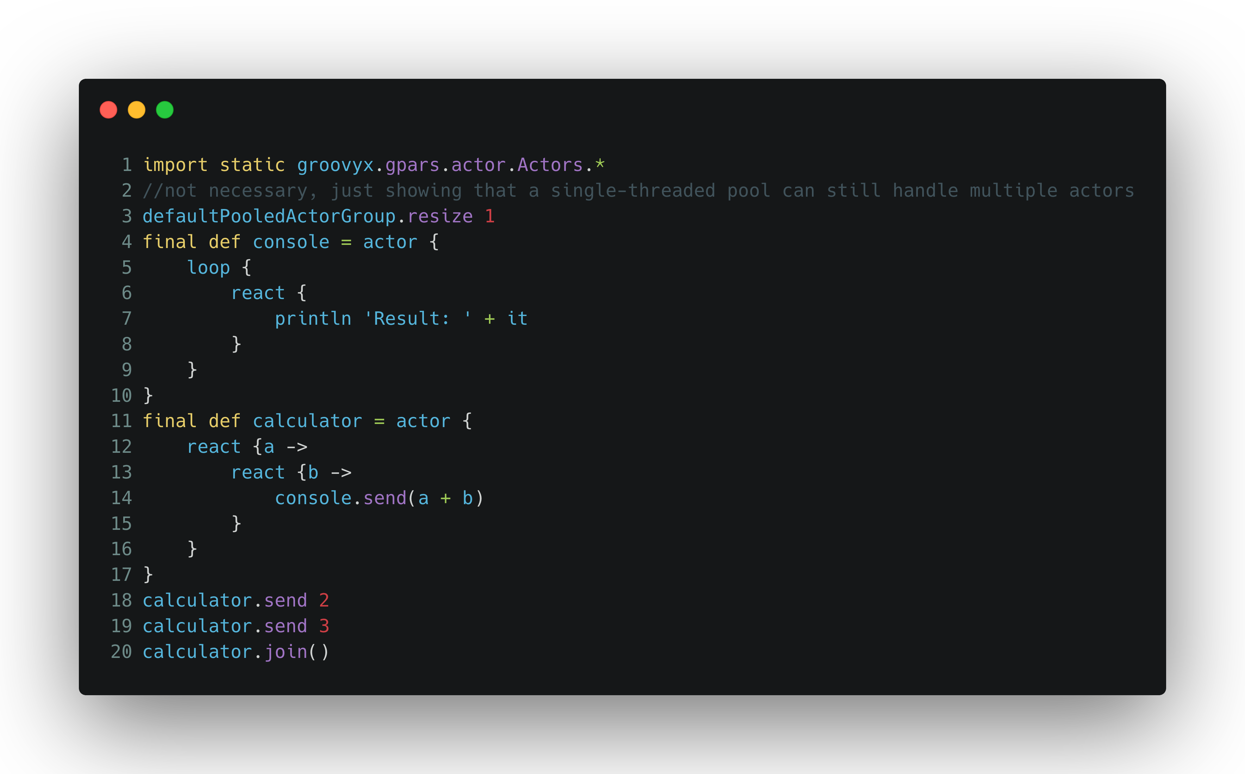
Example
The event-driven actor receives two numeric messages, generates a sum and sends it
Loop() – used to iterate through incoming messages.
React() - to receive incoming messages
reply() – to send messages
All are passed closure method body parameters

Slide 13
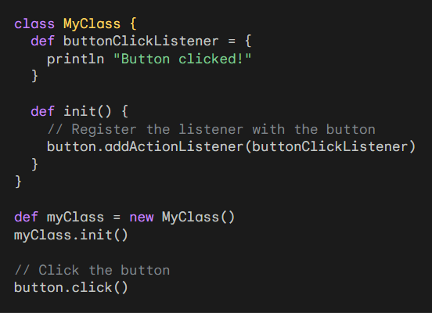
Event Handling
Event handling in Apache Groovy is similar to other programming languages, but it has some additional features and syntax that make it easier to implement.
Groovy also provides an event bus that can be used to communicate between different parts of an application using events.
Event handling is a powerful way to decouple different parts of an application and make it more modular and reusable. Groovy provides a number of features that make it easy to implement event handling in your applications.

Slide 14
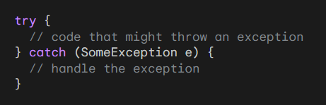
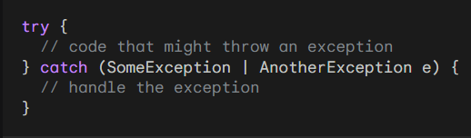
Exception Handling
Exception handling in Apache Groovy is the same as in Java. We use the try-catch block to catch an exception and handle it.
We can also use the multi-catch block to catch multiple exceptions at the same time.

Slide 15
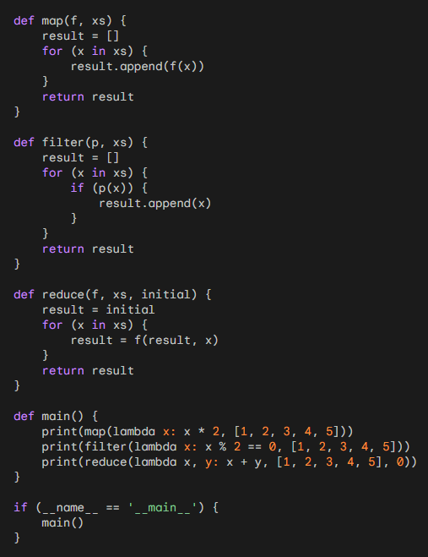
Functional Programming
Apache Groovy is a dynamic programming language for the Java platform that supports multiple programming paradigms, including functional programming.
Groovy provides a number of features that make it well-suited for functional programming, including:
Closures
Higher order functions
Currying
Function composition
Pure functions
Immutability
Recursion
Tail call optimisation

Slide 16
Command pattern
Execute Around pattern
Memoization
Collect - map operation
Filter
Reduce
Map filter reduce
Strategy pattern

Slide 17
Fitness Consultation App
A web application where users can sign up to seek consultation from fitness trainers.
Two parties – Trainer & Client

Slide 18
Features
Both can sign in/sign up
Clients can view and search trainers based on the services provided by them
Clients can receive consultation by scheduling appointments for in-person meetings, watching videos uploaded by the trainer.
All of the above within a transaction called ‘consultation’ between trainer & client.
Clients will be able to give a rating & feedback to their trainers, average of which will be the Trainer’s overall rating

Slide 19
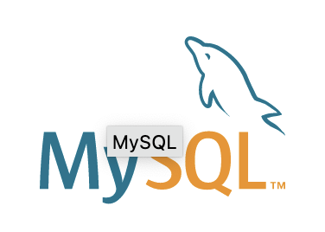
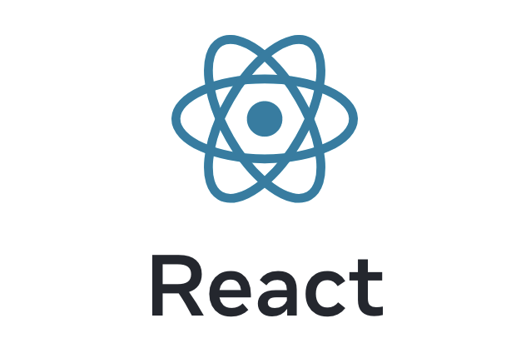

Tech Stack
Frontend: React
Backend: Grails Framework (Full-stack framework for Apache groovy)
Database: MySQL

Slide 20

THANK YOU

